Slide 1
Explore Xperience
Track1_Applied_CC_for_Software_Development​
Presented By:
1.SHAIK NOORULLAH-20RU1A0549
2. KAMBHAM REDDI BHARGAVI-20RU1A0523
3.SHAIK MOHAMMED SUFIAN-20RU1A0547
4.HARIJANA KRISHNAVENI-21RU5A0505
Guided By: Hrishikesh Mahure
Ankit Dixit

Slide 2
OUTLINE
Abstract
Problem Statement (Should not include solution)
Aims , Objective & Proposed System/Solution
System Design
System Development Approach(Technology Used)
Algorithm & Deployment
Sample Screenshots
Conclusion
Future Scope
References

Slide 3
Abstract
This presentation will introduce a new traveling website that aims to solve the problems of existing travel websites by providing a more user-friendly interface, a wider range of travel options, and more competitive prices. The website will also use artificial intelligence to recommend personalized travel itineraries to users based on their preferences

Slide 4
Problem Statement
Existing travel websites are often difficult to use, have limited travel options, and charge high prices. Additionally, many travel websites do not personalize their recommendations to users. This can make it difficult for users to find the best travel deals and plan the perfect trip.

Slide 5
Proposed Solution
User-Friendly Interface:
Intuitive and easy-to-navigate design.
Search for flights, hotels, and more by destination, date, and budget.
Various filters available for refining search results.
Wide Range of Travel Options:
Comprehensive selection, including flights, hotels, car rentals, and activities.
The website will also offer package deals that include multiple travel options.
Competitive Pricing:
Competitive and affordable prices across all travel options.
Attractive discounts for users who book their travel in advance

Slide 6
System Architecture
Frontend: The frontend will be responsible for displaying the website to users and allowing them to interact with the system. The frontend will be developed using a JavaScript framework, such as React or Angular.
Backend: The backend will be responsible for processing user requests and generating responses. The backend will be developed using a programming language, such as Python or Java.
Database: The database will store all of the data for the website, such as flight information, hotel
information, and activity information. The database will be developed using a relational database
management system (RDBMS), such as MySQL or PostgreSQL.

Slide 7
System Deployment Approach
Develop and test the system in a development environment.
Prepare the production environment by setting up the necessary servers and networks.
Deploy the system to the production environment using a suitable tool or technique.
Validate the system in the production environment to ensure that it is working properly.
Monitor and support the system after deployment by monitoring its performance, fixing bugs, and adding new features.
Considerations:
Security: Deploy the system in a secure manner using strong passwords, data encryption,firewalls and intrusion detection systems.
Scalability: Use load balancers and CDNs to scale the system to handle increased traffic.
Availability: Use redundant servers and load balancers to ensure high availability of the system

Slide 8
Algorithm & Deployment
1. The algorithm will first collect information about the user's preferences, such as their budget, travel
interests, and desired activities.
2. The algorithm will then search for travel options that match the user's preferences.
3. The algorithm will then generate a travel itinerary that includes the following:
Flights
Hotels
Car rentals
Activities
The algorithm will then present the travel itinerary to the user.

Slide 9
Requirements gathering:
The first phase will involve gathering requirements from users and stakeholders. This will be done through surveys, interviews, and focus groups.
System design:
Once the requirements have been gathered, the system will be designed. This will involve creating a detailed architecture of the system and defining the different components that will make up the system.
System development:
The system will then be developed using the technologies that were selected in the system design phase.
System testing:
The system will be thoroughly tested to ensure that it meets all of the requirements and that it is free of bugs.
System deployment:
Once the system has been tested and verified, it will be deployed to a production environment.

Slide 10
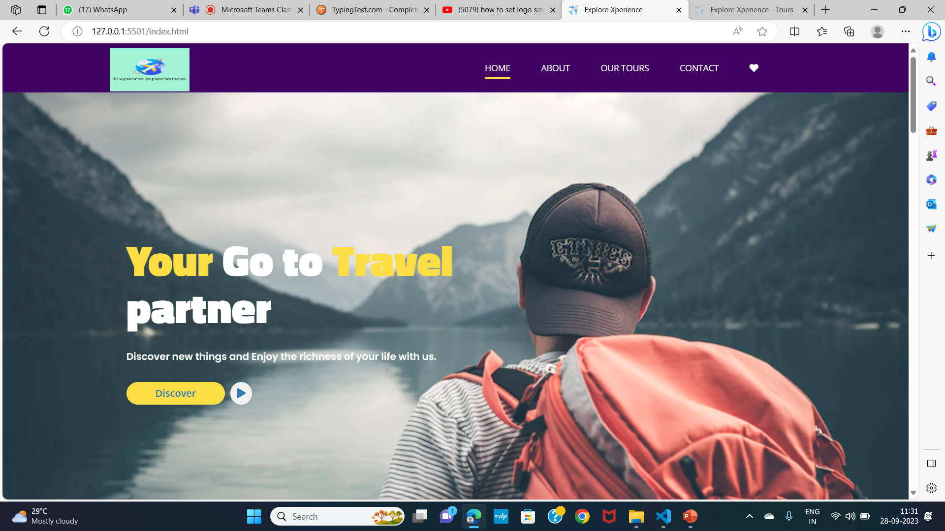
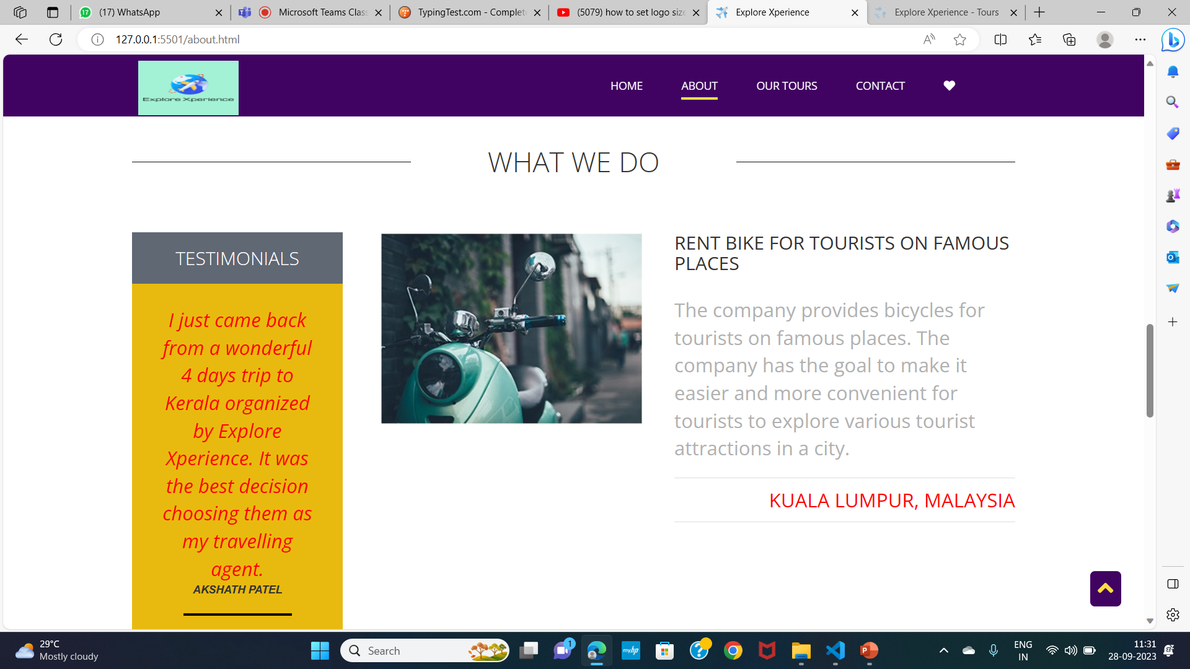
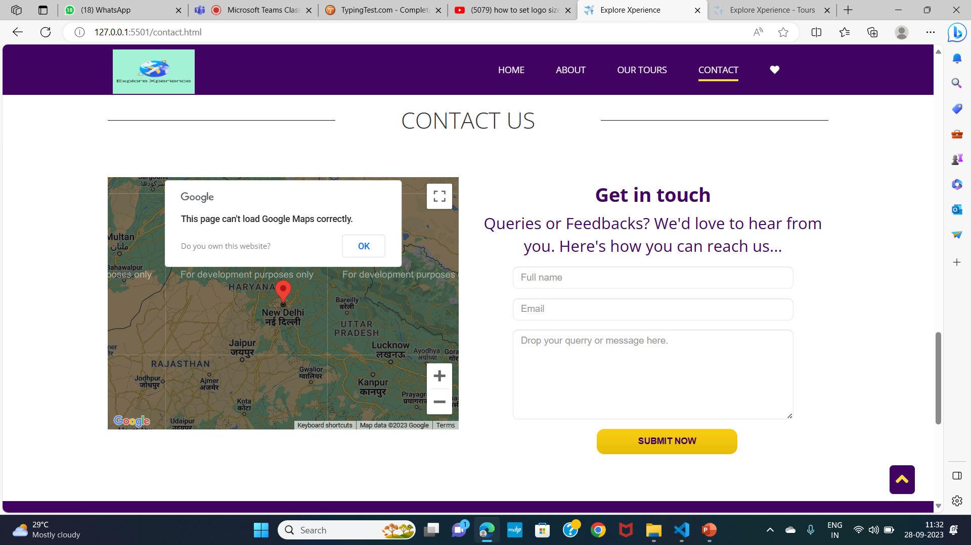
Sample Screenshot

Slide 11
conclusion
In conclusion, Explore Xperience is your one-stop shop for adventure travel. We offer a wide range of unique and unforgettable experiences, from exploring ancient ruins to trekking through lush rainforests to sailing through crystal-clear waters.
We are passionate about helping our customers create memories that will last a lifetime. That's why we offer a personalized service and work with you to create a trip that is tailored to your interests and budget.
We also understand that safety is a top priority for our customers. That's why we partner with only the most reputable tour operators and guides.
If you are looking for an adventure travel experience that you will never forget, then Explore Xperience is the right choice for you.

Slide 12
Future Scope
In the future, our Explore Xperience websites will leverage advanced AI algorithms for hyper-personalized trip recommendations, creating seamless and tailored experiences for each user. Blockchain technology will ensure secure and transparent transactions, enhancing customer trust. Virtual Reality (VR) and Augmented Reality (AR) will enable immersive virtual tours, allowing travelers to explore destinations before booking. Integration with IoT devices will provide real-time travel updates and enhance convenience. Sustainability initiatives and eco-friendly travel options will be integral, aligning with the growing demand for responsible tourism.

Slide 13
Reference:
https://github.com/Noor-09/ExploreXperience

Slide 14
THANK YOU

